Slide 1




Slide 2
Action, Innovation and Solidarity In Motion -- Building on momentum to close the gaps and leave no one behind in West and Central Africa
Patrick Brenny, UNAIDS RST-WCA

Slide 3
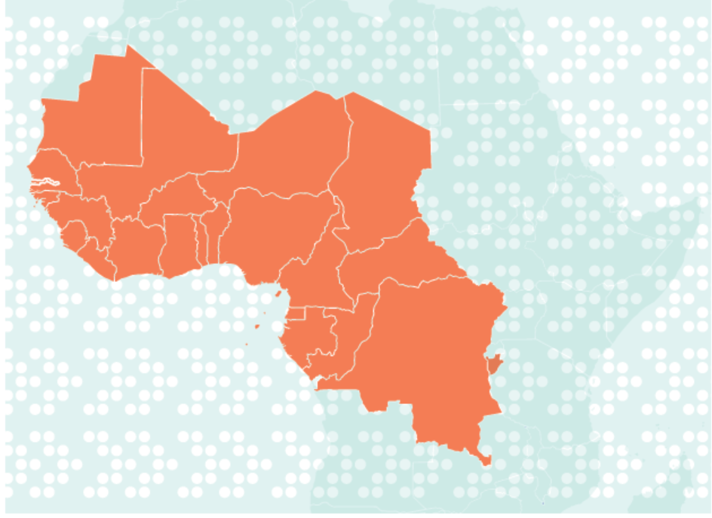
Context in West and Central Africa
Tangible progress made since the call for actions in 2016 (HLM)
Concerns in key trends of the epidemic
  7% of world population but 17% of all People Living with HIV worldwide (6.1 million in 2017)
  30% of all AIDS related deaths and 21% of new infection worldwide
  26% coverage of ART treatment among children
Humanitarian and security situation
Low scale up efforts to reach the 90-90-90 targets

Slide 4
The WCA catch-up plan
To be implemented from 2017 to end 2018
  8 countries in the 1st wave (80% of PLHIV in WCA)
  10 additional countries thereafter
Strategic objectives by end 2018
  At least 850 000 people, including 60 000 children, diagnosed as living with HIV but not yet enrolled in care will receive sustained high-quality antiretroviral therapy by mid-2018. This represents an estimated 65% of the number of previously tested but untreated people.
  An additional 250 000 people living with HIV, including 60 000 children, have been newly tested, know their HIV-positive status and are linked to sustained high-quality antiretroviral therapy by mid-2018.
  An additional 100 000 pregnant women living with HIV will receive sustained high-quality antiretroviral therapy.

Slide 5
Key achievements (a)
Increase in test and treatment outcomes

Slide 6
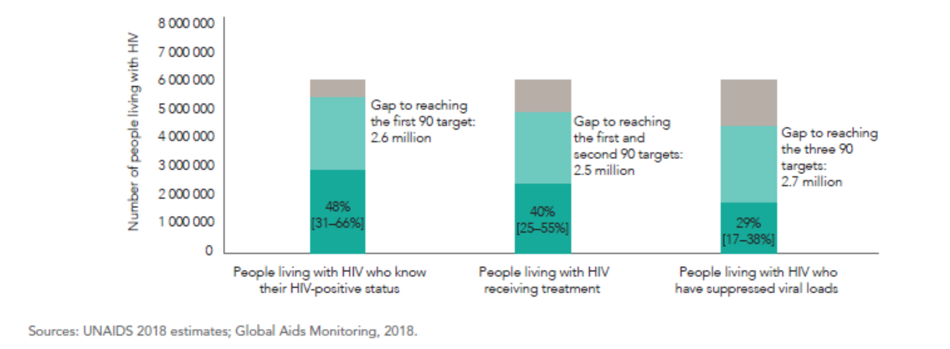
Key achievements (a)
Increase in test and treatment outcomes
Test and treatment cascade in WCA in 2017

Slide 7
Key achievements (b)
Communities, affected populations and local authorities plan and lead the AIDS response
Changes in service delivery
Testing options are being broadened:
Focus on index-based testing
Self- and home-based testing
Location-based testing
Public-private partnerships
Voluntary and provider-initiated counselling
Engaging the most affected populations in testing
WCA political leadership exerts robust leadership to Fast-Track the response
Existing and new resources are increasingly focalised on the fast-track efforts
Health service delivery is becoming more and more diversified – user fees an issue to address
Delivery of treatment is more flexible:
Offer treatment immediately after a positive test
Longer-lasting prescriptions
Community-based
Seek and treat men who miss treatment
Increased use of new technologies:
PreP
Point-of-Care tests
VL - testing

Slide 8
Unfinished business (a)
Stagnation in pregnant women access to ARV

Slide 9

Unfinished Business (b)
Children are being left behind
Cascade of services for preventing vertical transmission, number of new infections and transmission rate, 2017
Eastern and southern Africa
Western and central Africa

Slide 10
Unfinished business (c)
Insufficient resources to sustain the gains

Slide 11
Action, Solidarity and Innovation to achieve fast-track targets by 2020 (a)
Enhanced political mobilization, advocacy and policy change to support innovation, investment and acceleration – leadership needed now more than ever.
Increased and renewed involvement of and partnership with civil society in community-based service delivery for 90-90-90 – community responses to reach those being left behind:
  Focus on index-case testing (and treatment) for young women, young men and adolescents
  Accelerated pediatric testing and treatment – elimination is the goal
  Address stigma, discrimination and service access for key populations and PLHIV

Slide 12
Action, Solidarity and Innovation to achieve fast-track targets by 2020 (b)
(3) Innovate, promote and expand diversified testing and treatment service delivery approaches – “demedicalisation”
(4) Renewed and intensified focus on prevention is critical ➔ for every three dollars going to treatment, one should go to combination prevention efforts
(5) Shared Responsibility and Global Solidarity on the Fast Track if we are to succeed
  Sustained and increased domestic financial resources
  Partners must continue to invest strategically to leverage results
  Innovation in the financing of health -- elimination of user fee models throughout the region, adoption of UHC

